Slide 1
Factors Associated with Cardiovascular Disease (CVD)
Statistical Analysis of Clinical and Demographic Variables
GROUP C MEMBERS: Leilah Beth Colley – 206520938
Zoe Cassidy John – 223043739
Simiso Mbokazi – 222073091
Ghyandra Naidoo – 223078134

Slide 2
AIM
Identify factors associated with cardiovascular disease (CVD)
Examine demographic and clinical variables
Determine which significantly influence CVD likelihood

Slide 3
DATASET OVERVIEW
299 patients with demographic & clinical data
Variables: age, gender, smoking, anemia, diabetes, high BP, CPK, ejection fraction, platelets, serum sodium
Outcome: presence/absence of CVD
CVD = leading global cause of death → motivates analysis

Slide 4
DESCRIPTIVE SUMMARY
Categorical Variables:
27.1% had CVD
64.9% male | 32.1% smokers
Anemia 43.1% | Diabetes 41.8% | High BP 35.1%
Quantitative Variables:
Age: mean 60.8 yrs (40–95)
CPK: highly variable, right-skewed
Ejection Fraction: avg 38% → moderately reduced
Sodium: stable (mean 136.6 mEq/L)

Slide 5
Chi-Square test results
No significant associations (p > 0.05) between CVD and:
Anemia
Diabetes
High Blood Pressure
Gender
Smoking
➡️ Suggests no single categorical variable alone predicts CVD.
➡️ Leads to logistic regression to control for multiple factors.

Slide 6
LOGISTIC REGRESSION MODEL
Model:
logit(P(CVD=Yes)) = β₀ + β₁(age) + β₂(anemia) + … + β₁₀(smoking)
Model Significance: p < 0.0001 → at least one predictor matters.
Significant Predictors:
Age (p = 0.0052)
Ejection Fraction (p = 0.0338)
Serum Sodium (p < 0.0001)

Slide 7
STEpwise model refinement
AIC reduced from 351.3 → 319.1 as predictors added
Final model: Age, Ejection Fraction, Serum Sodium
Hosmer–Lemeshow test: p = 0.6152 → good model fit
C-statistic = 0.715 → fair predictive accuracy
No overdispersion or influential points

Slide 8
Key Predictors (Odds Ratios)
Predictor | OddsRatio | 95% CI | Significance | Interpretation
Age | 1.034 | 1.010–1.058 | Significant (p = 0.0043) | OR > 1, meaning a risk factor. Each additional year of age increases the odds of CVD by ~3.4%.
Ejection Fraction | 0.975 | 0.951–1.000 | Significant (p = 0.0494) | OR < 1, meaning a protective effect. Each 1% increase in ejection fraction decreases the odds of CVD by ~2.5%.
Serum Sodium | 0.861 | 0.805–0.922 | Highly significant (p < 0.0001) | OR < 1. Each mmol/L increase in serum sodium decreases the odds of CVD by ~13.9%.

Slide 9
Model predictions
Older age + low ejection fraction → higher risk
Observation | CVD | Age | Ejection Fraction | Serum Sodium | Predicted Probability
1 | Yes | 75 | 20 | 130 | 0.61817
2 | No | 55 | 38 | 136 | 0.23980
3 | No | 65 | 20 | 129 | 0.67087

Slide 10
conclusion
Significant predictors:
Age ↑ risk
Higher Ejection Fraction & Serum Sodium ↓ risk
Non-significant: Anaemia, Diabetes, High BP, Gender, Smoking
Model fits data well and provides valuable insight into key risk factors for CVD.

Slide 11
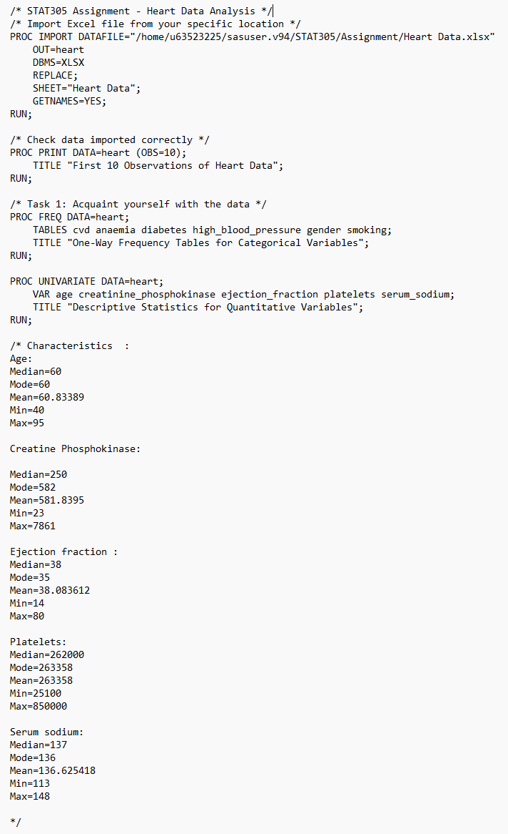
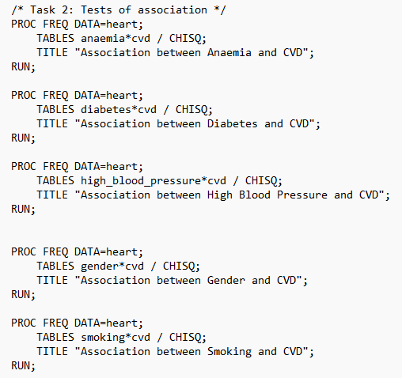
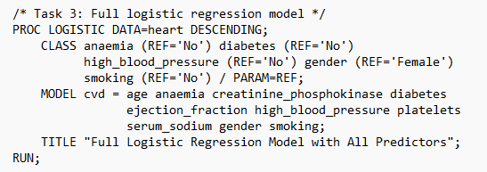
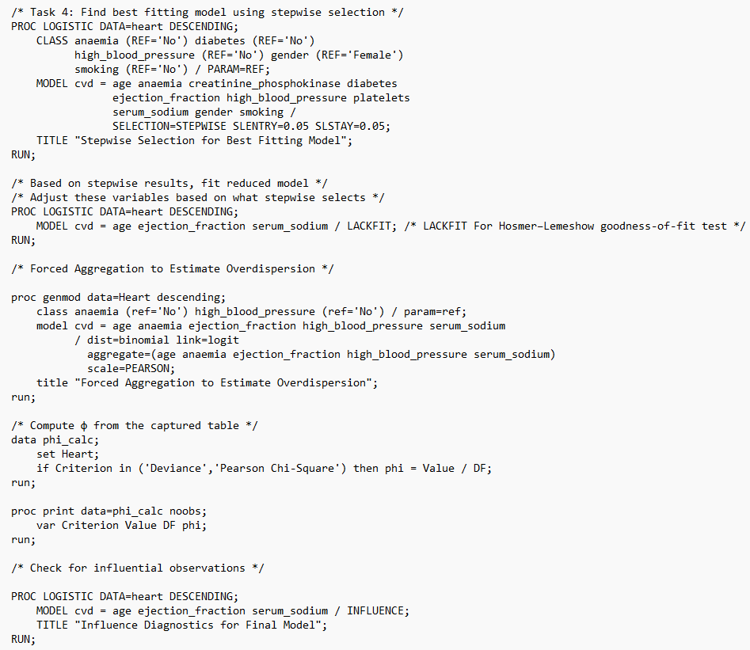
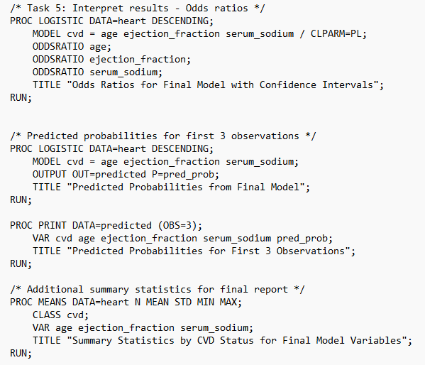
SAS Syntax

Slide 12
THANK YOU

